Slide 1

Operating System
Nazneen Akhter
Assistant Professor
Dept. of ICT
Faculty of Science and Technology
Bangladesh University of Professionals (BUP)

Slide 2
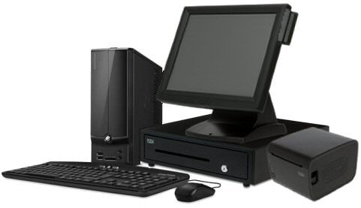
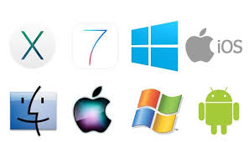

Introduction
An operating system is a program that manages a computer’s hardware
It also provides a basis for application programs
It acts as an intermediary between the computer user and the computer hardware
It is a set of programs that manage computer hardware resources and provide common services for application software

Slide 3
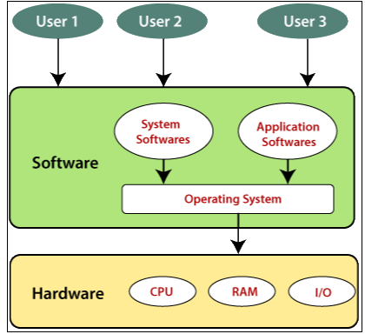
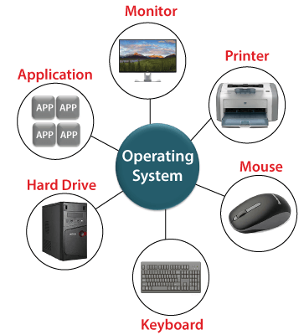
Introduction (Cont.)

Slide 4
Introduction (Cont.)
Operating system goals:
Execute user programs and make solving user problems easier
Make the computer system convenient to use
Use the computer hardware in an efficient manner

Slide 5

Introduction (Cont.)
OS is a resource allocator
- Manages all resources
- Decides between conflicting requests for efficient and fair resource use
OS is a control program
- Controls execution of programs to prevent errors and improper use of the computer

Slide 6

Computer System Structure
Computer system can be divided into four components:
Hardware – provides basic computing resources (CPU, memory,
I/O devices)
Operating system- Controls and coordinates use of hardware
among various applications and users
Application programs – define the ways in which the system resources are used to solve the computing problems of the users (Word processors, compilers, web browsers, database systems, video games)
Users- People, machines, other computers

Slide 7
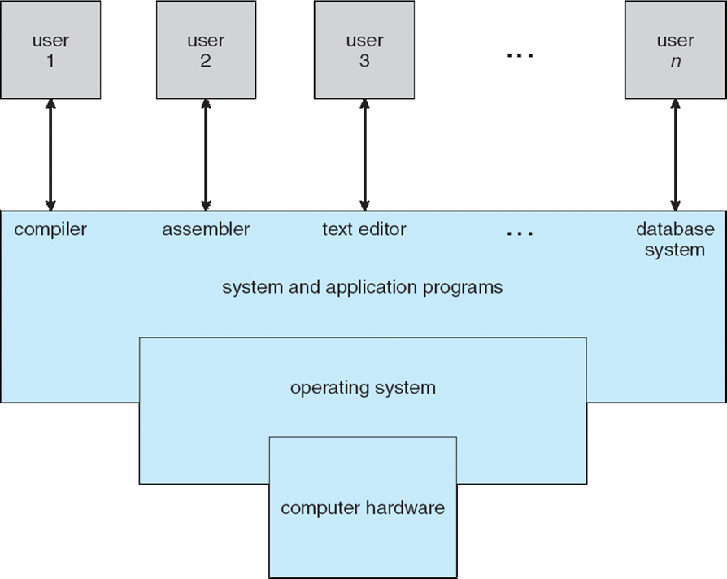
Four Components of a Computer System

Slide 8
Kernel
“The one program running at all times on the computer” is the kernel
• A core component of Operating System without which OS can't work
• Kernel is the nervous system of OS
• It is the central core of OS
• It controls everything in OS including I/O Management, Process Management and so on
• It is a bridge between applications and the actual data processing done at the hardware level
• It acts as an interface between the user applications and the hardware

Slide 9
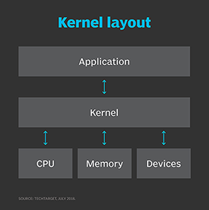
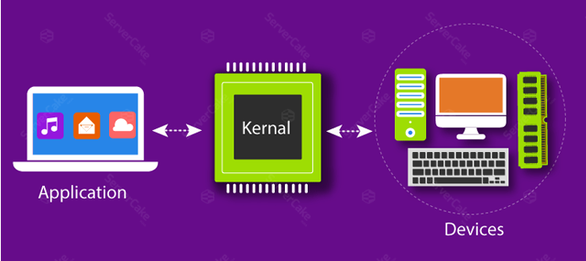

Slide 10
Responsibilities of Kernel
1. Central Processing Unit
The Kernel takes responsibility for deciding at any time which of the many running programs should be allocated to the processors
2. Random Access Memory
Random Access memory is used to store both program instructions and data. Often multiple programs will want access to memory, frequently demanding more memory than the computer has available. The Kernel is responsible for deciding which memory each process can use, and determining what to do when not enough memory is available

Slide 11
Responsibilities of Kernel (Cont.)
3. Input/output Devices
The Kernel allocates requests from applications to perform I/O to an appropriate device and provides convenient methods for using the device.
4. Memory Management
The Kernel has full access to the system's memory and must allow processes to safely access this memory as they require it
5. Device Management
A Kernel must maintain a list of available devices. This list may be known in advance configured by the user or detected by the operating system at run time (normally called plug and play)

Slide 12
Features provided by Kernel
1) Scheduling of Process (Dispatching)
2) Inter-process Communication
3) Process Synchronization
4) Context Switching
5) Manipulation of Process Control Blocks
6) Interrupt Handling
7) Process Creation and Destruction
8) Process Suspension and Resumption

Slide 13
Bootstrap Program
A bootstrap program is the first code that is executed when the computer system is started
The entire operating system depends on the bootstrap program to work correctly as it loads the operating system
Bootstrap program is loaded at power-up or reboot
  Typically stored in ROM or EPROM, generally known as firmware
  Initializes all aspects of system
  Loads operating system kernel and starts execution

Slide 14
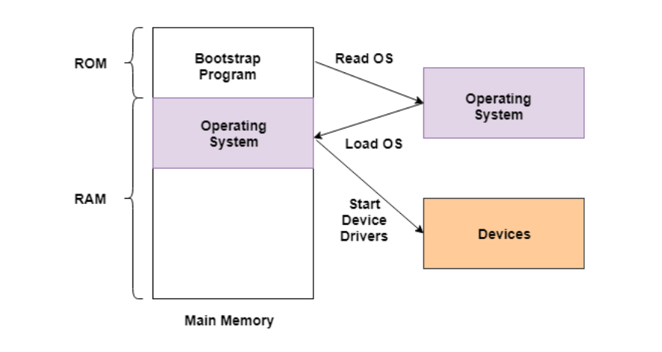
Bootstrap Program (Cont.)
The bootstrap program is a part of ROM which is the non-volatile memory
The operating system is loaded into the RAM by the bootstrap program after the start of the computer system
Then the operating system starts the device drivers

Slide 15
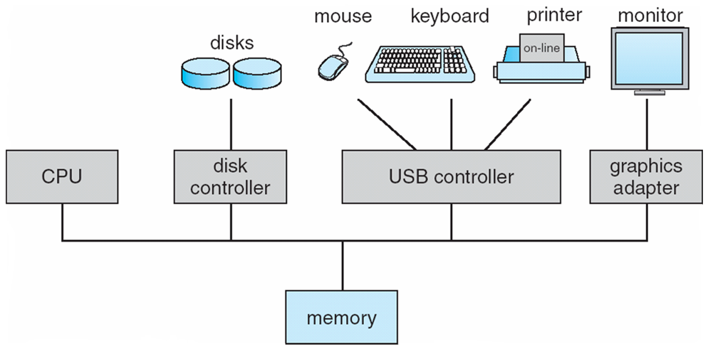
Computer System Organization
Computer-system operation:
  - One or more CPUs, device controllers connect through common bus providing access to shared memory
  - Concurrent execution of CPUs and devices competing for memory cycles

Slide 16
Computer-System Operation
I/O devices and the CPU can execute concurrently
Each device controller is in charge of a particular device type
Each device controller has a local buffer
CPU moves data from/to main memory to/from local buffers
I/O is from the device to local buffer of controller
Device controller informs CPU that it has finished its operation by causing an interrupt

Slide 17
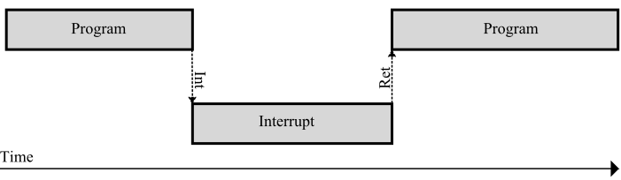
Common Functions of Interrupts
Interrupt transfers control to the interrupt service routine generally, through the interrupt vector, which contains the addresses of all the service routines
Interrupt architecture must save the address of the interrupted instruction
A trap or exception is a software-generated interrupt caused either by an error or a user request
An operating system is interrupt driven

Slide 18
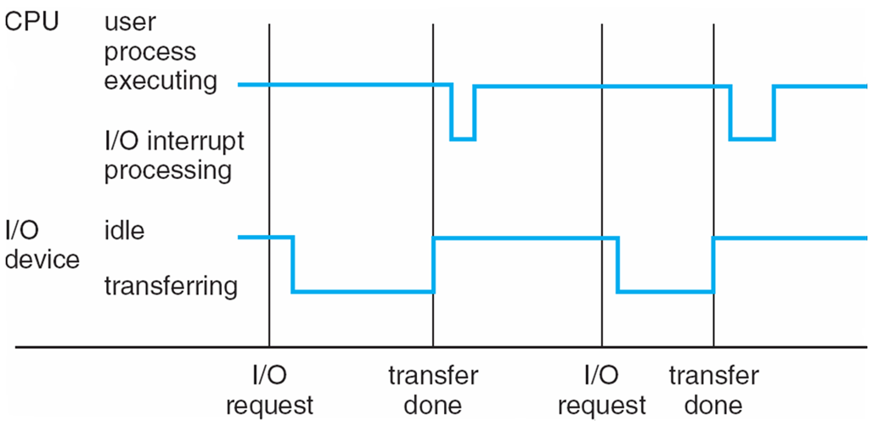
Interrupt Timeline

Slide 19
Thank you
Questions?

